Slide 1
Food Economics
The role of agricultural and livestock production in the World
Angela Bissacco, Jacopo Magliani

Slide 2
Index
Introduction
Dataset
Exploratory Data Analysis
Models
GAM
ARIMA
ARIMAX
Conclusions

Slide 3
Introduction

Slide 4
About the project
Getting food has always been part of human beings’ daily activities, whether it comes from agricultural work or livestocks.
In this project, our goal is to find out how closely agriculture production and GDP per capita are related and whether the application of different models can reveal similarities between different countries.

Slide 5
The primary sector
The Italian primary sector generated only 2% of Italy GDP in 2021. This result was achieved by employing around 900,000 people (<1% of the population¹).
This small impact can be seen especially in those countries which are more focused on services and production, while this percentage ​rises in countries that are dedicated to the export of raw materials, such as the BRICS countries (Brazil, Russia, India, China, South Africa).
¹· Istat data

Slide 6
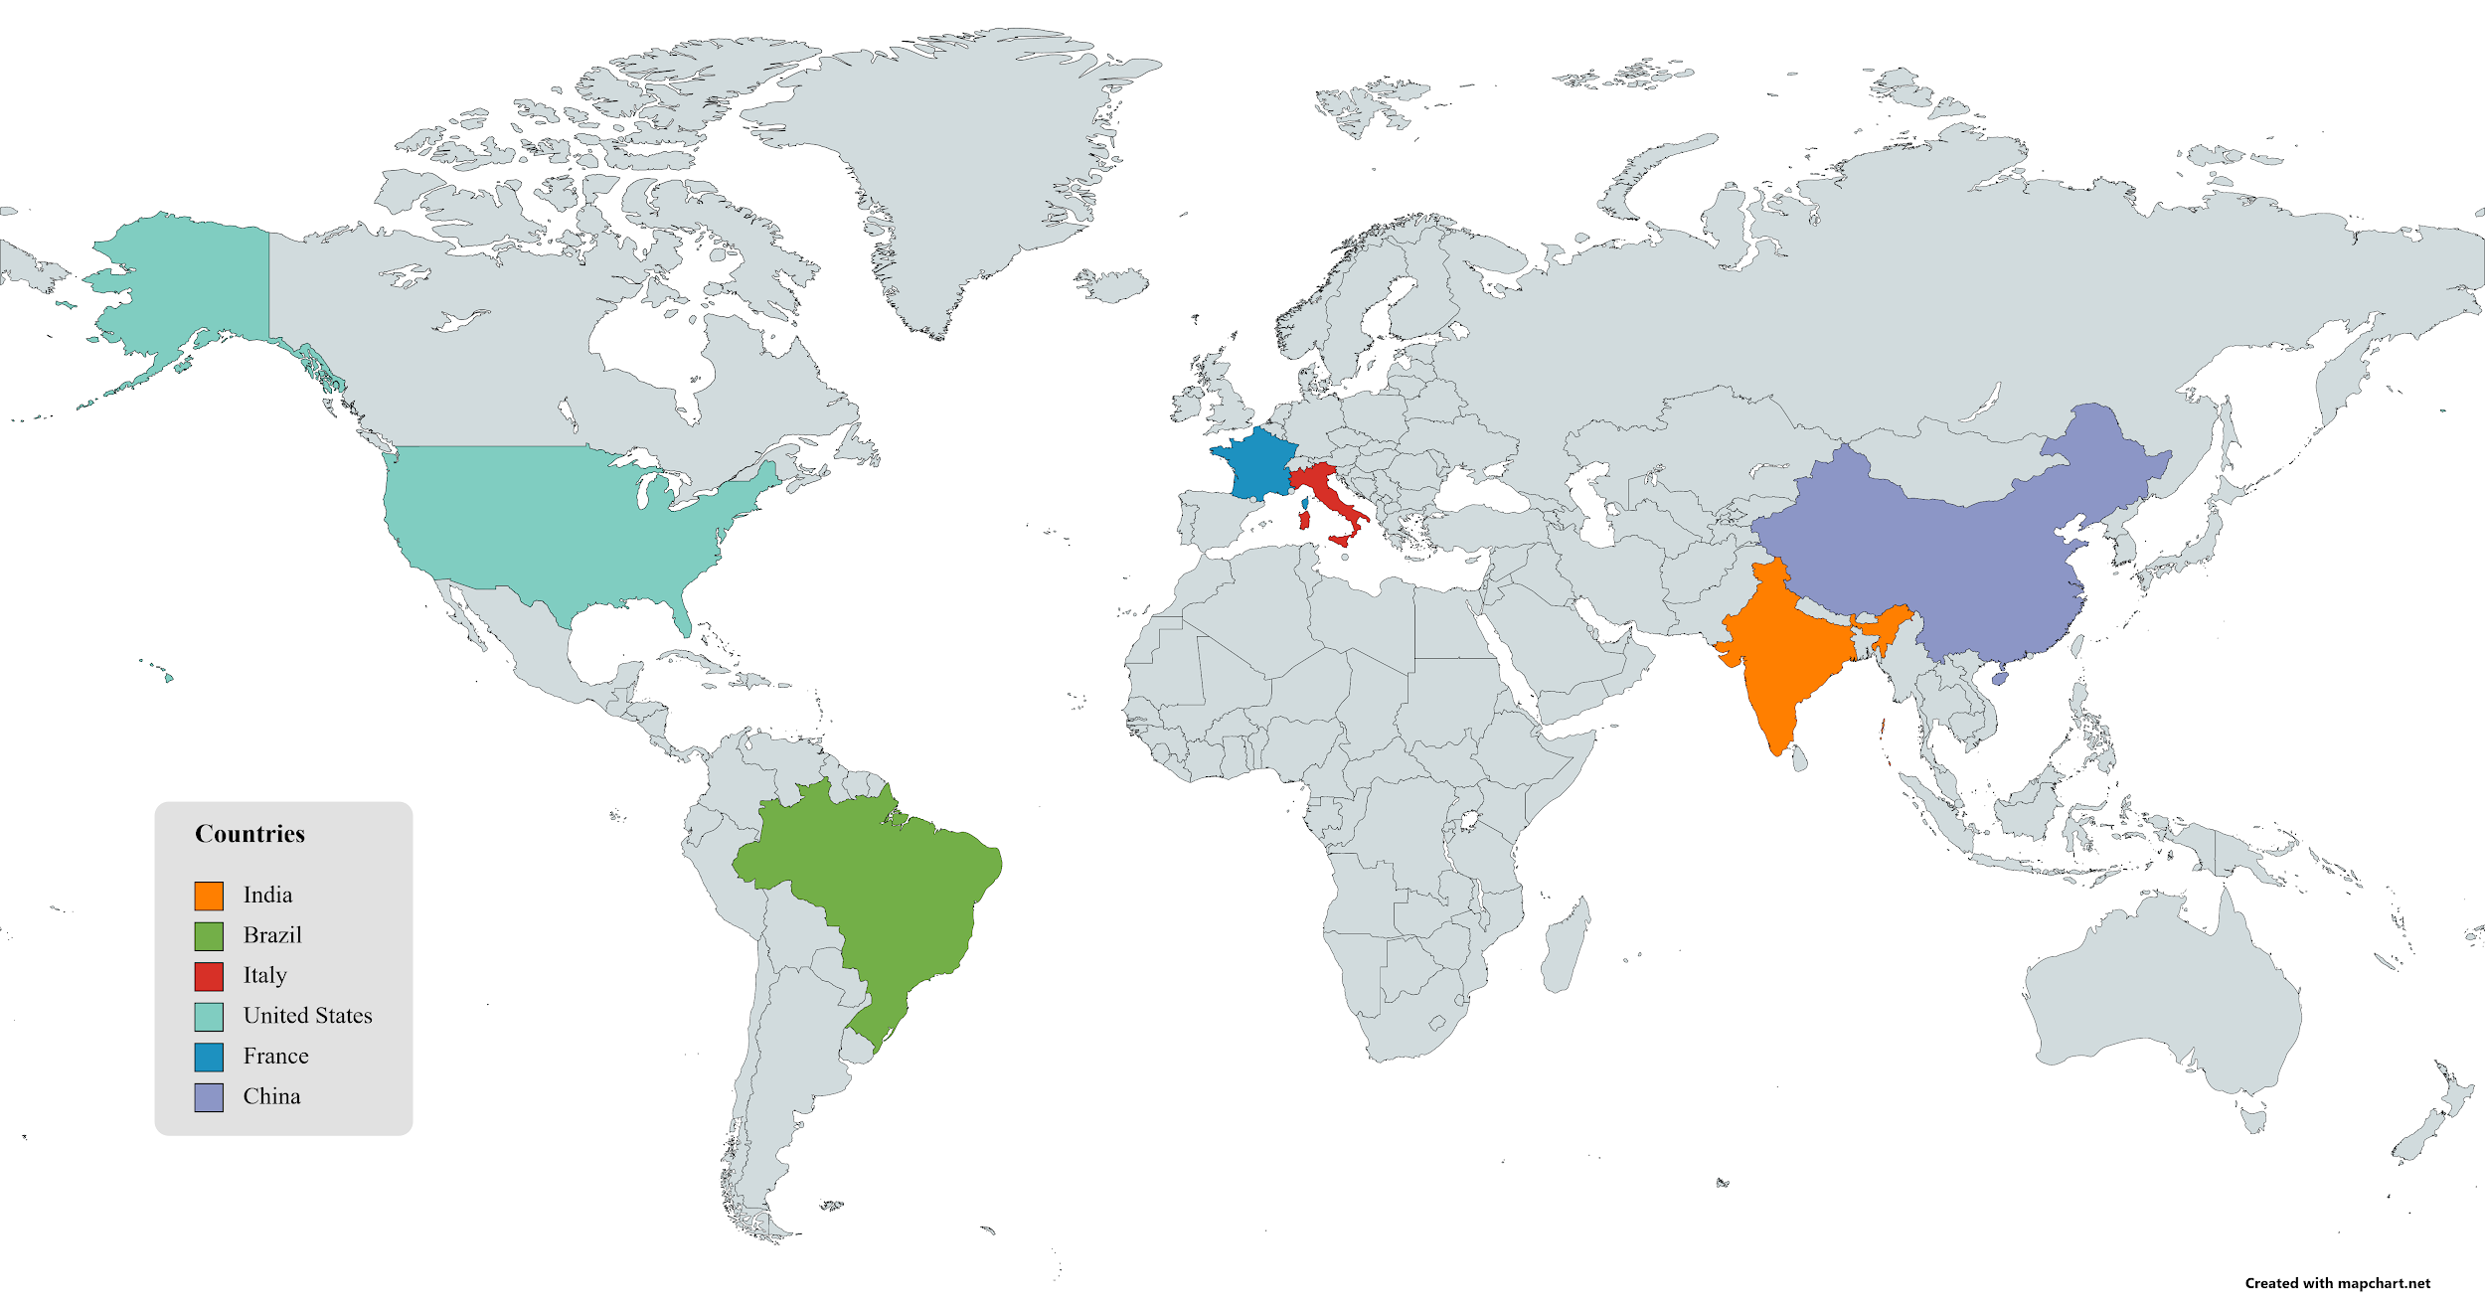
Countries considered

Slide 7
Dataset

Slide 8
Datasets used
Food Bank of the World | Kaggle
GDP (US$) | The World Bank
Population, total | The World Bank
Countries Codes and Coordinates | GitHub

Slide 9
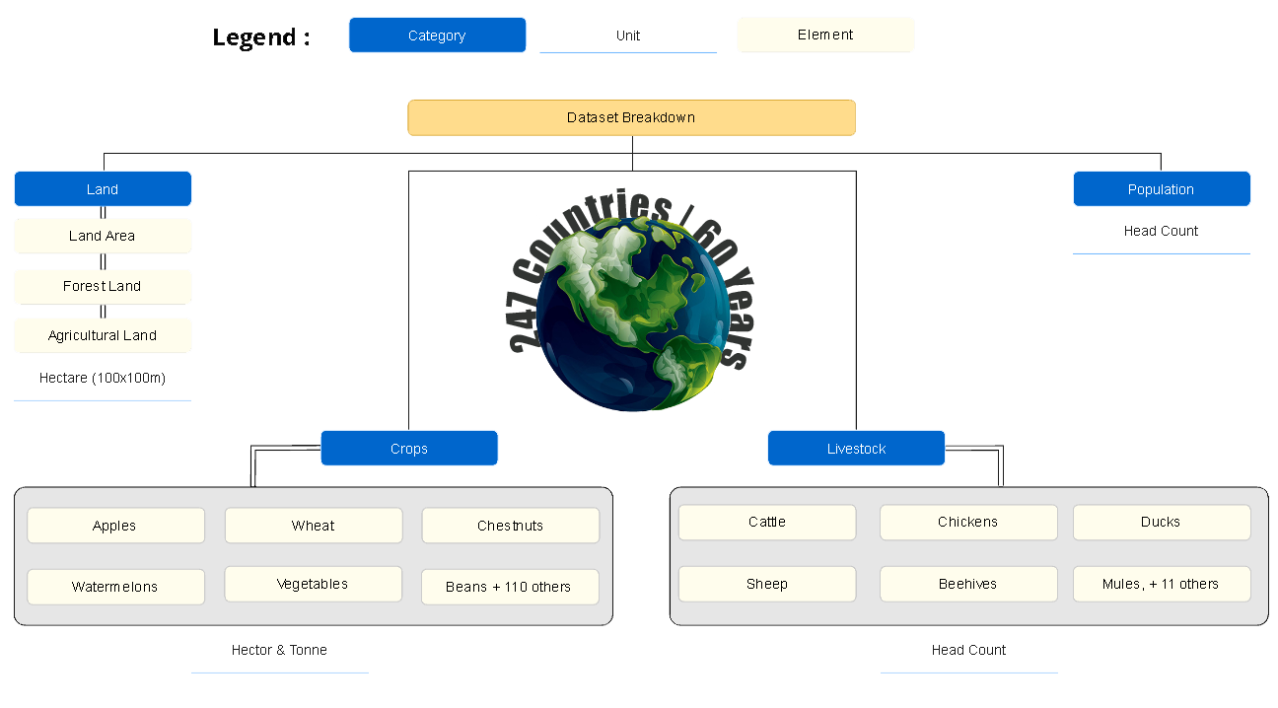
Food bank of the world dataset

Slide 10
Exploratory data analysis

Slide 11
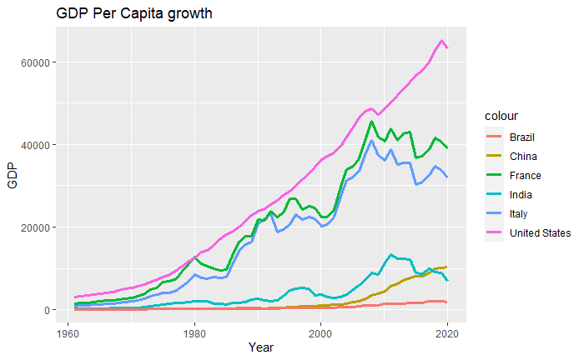
US is consistently at the top
Italy & France have similar growth, typical of the EU area
China has reached and overtaken India, a country with very similar population size.
Brazil grew very slightly
The 2008 crisis and COVID-19 pandemic hit the economies of US, Italy, France and India but not China and Brazil

Slide 12
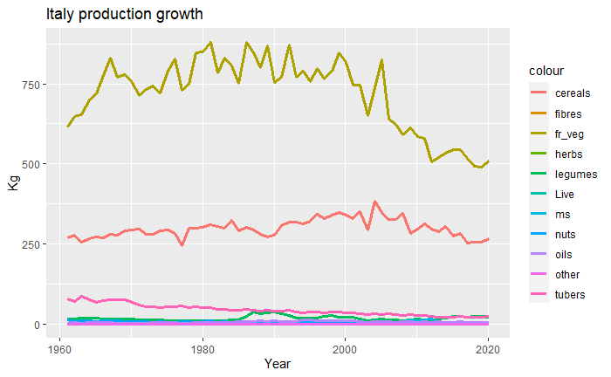
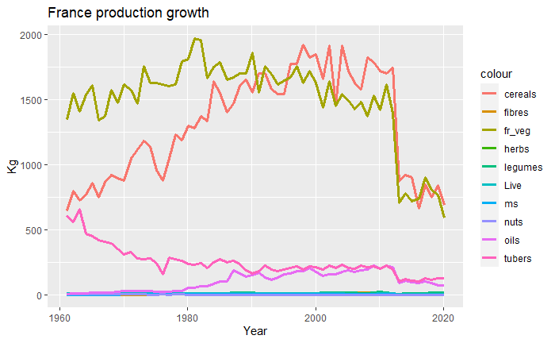
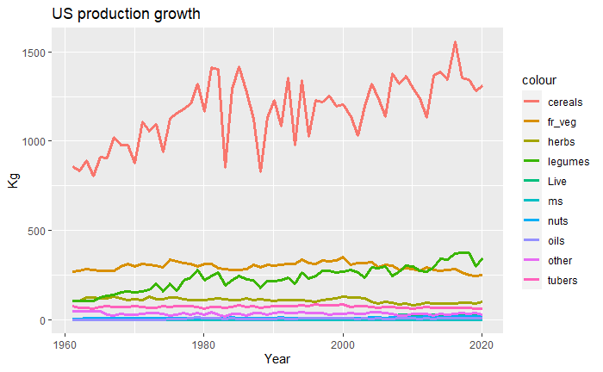
We can observe:
The importance of cereals, fruit and vegetables in all the sampled countries excluding Brazil
The stability of cereals in Italy and the huge drops in France in 2013

Slide 13
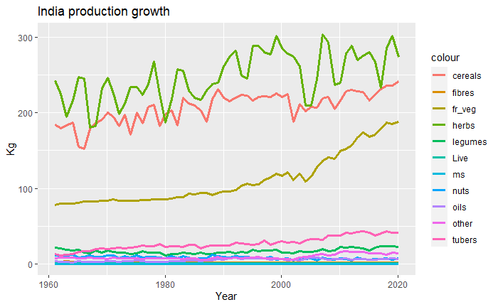
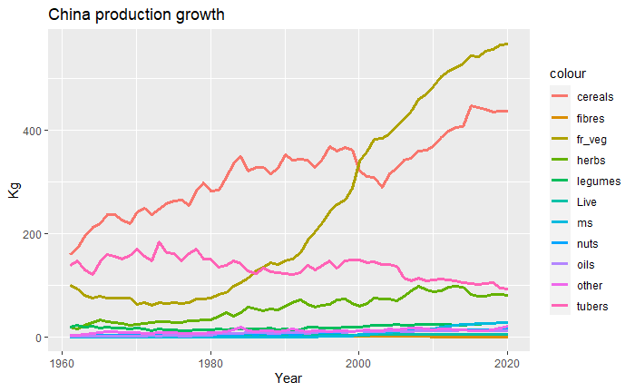
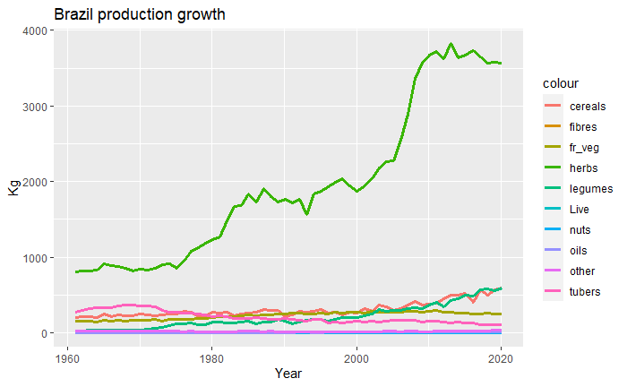
The fast increase in the production of fruits and vegetables in China
The importance of herbs (spices, tobacco, ...) in India and Brazil
Brazilian herbs production doubled in 2010s and then remained stable
All the other products remained quite stable

Slide 14
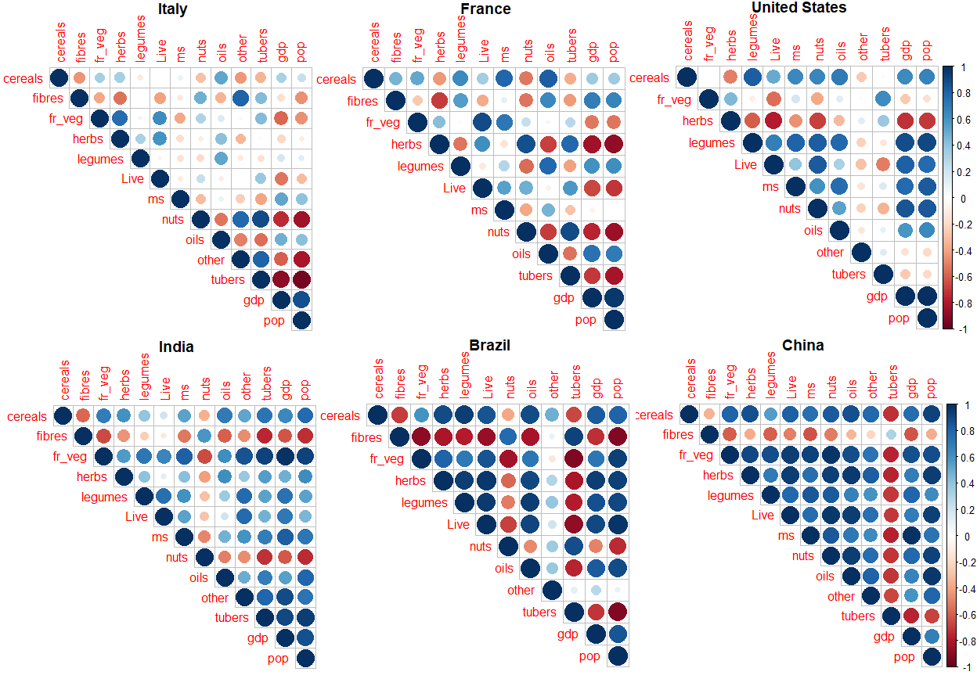
Correlation matrix of the countries

Slide 15
Models

Slide 16
General procedure
For each country we:
Extract a subset of features
Start with GAM as baseline using the extracted features
Perform ARIMA
Perform ARIMAX for each of the features

Slide 17
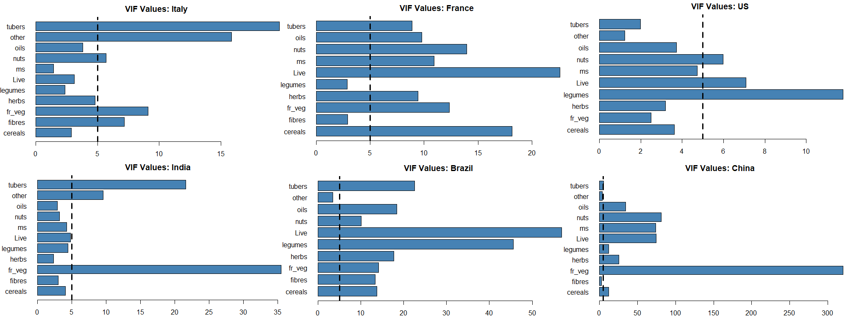
Extraction of features basing on VIF values

Slide 18
Generalized Additive Model (GAM)
For each country we have:
fitted a GAM model to the data
defined our scope list using as possible degrees of freedom a vector (2,3,4)
performed a stepwise regression using the fitted GAM as starting point and the defined scope.

Slide 19
These are the step-wise selection models obtained:
Italy -> gdp ~ cereals + s(Year, df = 4) + s(legumes, df = 4) + s(ms, df = 4)
France -> gdp ~ fibres + s(Year, df = 4) + legumes
US -> gdp ~ cereals + Year + s(fr_veg, df = 4) + s(ms, df = 4) + other + s(tubers, df = 3)
Brazil -> gdp ~ .
India -> gdp ~ cereals + s(Year, df = 4) + s(legumes, df = 2) + Live
China -> gdp ~ fibres + s(Year, df = 4) + other

Slide 20
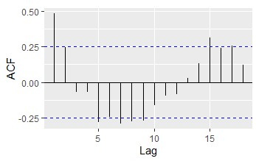
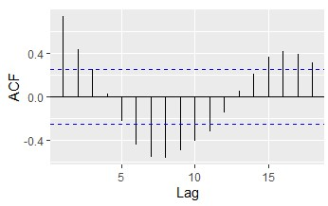
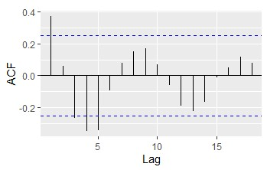
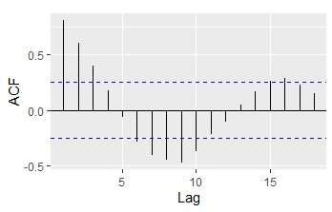
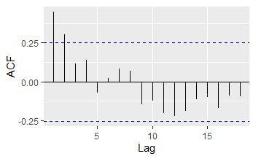
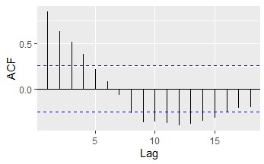
All the ACF plots of the residuals present a harmonic behaviour.
In addition, the values of the Durbin-Watson tests are always below 0.5
Italy
France
US
Brazil
India
China

Slide 21
ARIMA
Thanks to the auto.arima function in R we were able to identify the ideal parameters (p,d,q) for each country.
Country | Italy | France | US | China | India | Brazil
ARIMA (p,d,q) | (0,1,0) | (0,1,0) | (2,2,1) | (2,2,0) | (0,2,1) | (1,1,1)
ARIMA AIC | 1064.36 | 1072.62 | 937.48 | 749.78 | 648.57 | 963.75
One of the traits of our data is the absence of seasonality due to the yearly structure of the measurements.

Slide 22
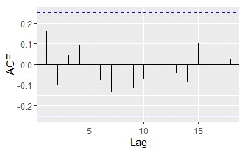
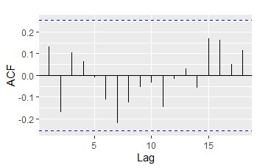
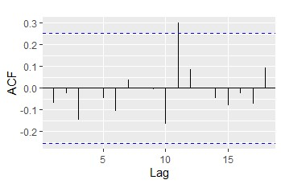
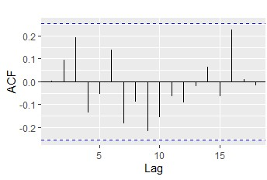
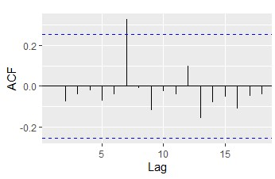
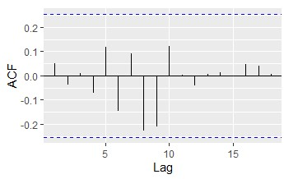
The harmonic behaviour has generally disappeared
Italy
France
US
Brazil
India
China

Slide 23
ARIMAX
We have used ARIMAX to incorporate data about the crops.
Compared to the results by ARIMA models, we got minimal improvements in terms of AIC only for Italy and France, for the other countries performances have worsened, even drastically in the case of China.
Country | Italy | France | US | China | India | Brazil
ARIMAX (p,d,q) | (0,1,0) | (0,1,0) | (2,2,1) | (1,1,0) | (1,1,1) | (0,1,1)
ARIMAX AIC | 1062.13 | 1071.79 | 938.72 | 788.40 | 654.12 | 965.06
For the BRICS countries the automatic procedure of ARIMA did not select the same (p,d,q) as before.

Slide 24
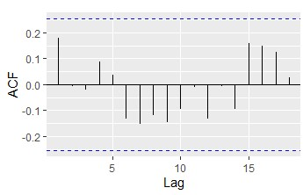

AIC differences
Italy ~ cereals
Italy ~ herbs
Looking at Italy, we can see that for different crops we obtain similar AIC values and ACF plots.
This behaviour can also be observed for the other countries.
Crop | cereals | herbs | legumes | live | ms | oils
AIC | 1062.13 | 1066.19 | 1065.21 | 1066.32 | 1065.44 | 1065.64

Slide 25
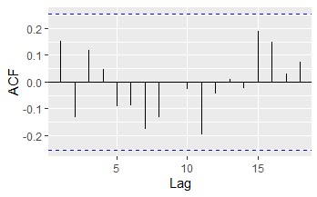
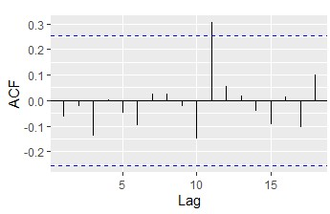
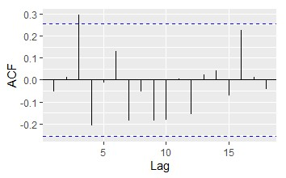
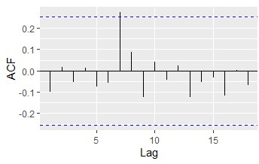
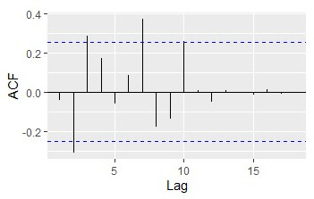
ACF plots are almost the same as those from ARIMA except for China, the country where the AIC has worsened the most
Italy ~ cereals
France ~ legumes
US ~ ms
Brazil ~ other
India ~ legumes
China ~ other

Slide 26
Conclusions

Slide 27
Overall Results
Country | Crops by VIF | GAM AIC | ARIMA (p,d,q) | ARIMA AIC | ARIMAX (p,d,q) | ARIMAX AIC | ARIMAX crop
Italy | cereals, herbs, legumes, live, ms, oils | 1101.63 | (0,1,0) | 1064.36 | (0,1,0) | 1062.13 | cereals
France | fibres, legumes | 1135.878 | (0,1,0) | 1072.62 | (0,1,0) | 1071.79 | legumes
US | cereals, frveg, herbs, ms, oils, other, tubers | 982.69 | (2,2,1) | 937.48 | (2,2,1) | 938.72 | ms
China | fibres, other | 867.39 | (2,2,0) | 749.78 | (1,1,0) | 788.40 | other
India | cereals, fibres, herbs, legumes, live, ms, nuts, oils | 647.20 | (0,2,1) | 648.57 | (1,1,1) | 654.12 | legumes
Brazil | other | 1073.22 | (1,1,1) | 963.75 | (0,1,1) | 965.06 | other

Slide 28
Main points
From the results obtained, the inclusion of data related to crops and livestocks for GAM and ARIMAX did not lead to significant improvements compared to ARIMA. This was to be expected given that we only considered the primary sector.
With our project we wanted to point out the differences and similarities between the countries:
The models achieved lower AIC values in BRIC countries compared to Italy and France but not to the US.
ARIMA prevails among the models, while GAM model is generally the worst, except for India.
ARIMA and ARIMAX models have extremely similar performances besides China and India, which are both the most populous countries in the world. For these countries the automatic procedure of ARIMA selected different parameters (p,d,q).
Generally the AIC difference between GAM and ARIMA is 40 but it is
larger when ARIMAX uses the feature “other” (rubber, seed cotton)
Among the dominant crops found in the EDA, “cereals” appear
only for the ARIMAX of Italy.

Slide 29
Possible expansions of the project
Focus on the Eurozone
Integrate environmental, cultural variables
Use subsets of individual variables (e.g. wheat, rice) rather than aggregated ones (cereals)

Slide 30

Thank you for your attention

